Slide 1
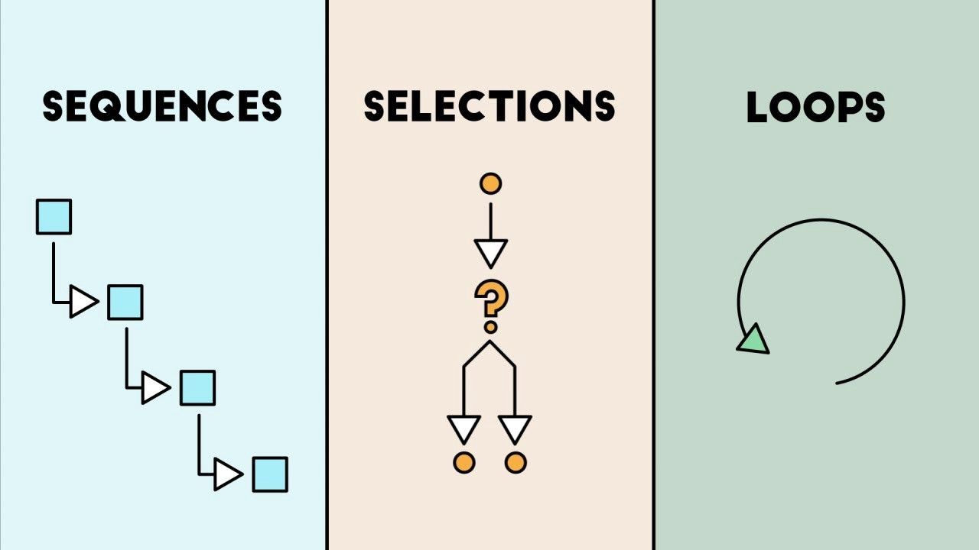

Selection
This work is licensed under a Creative Commons Attribution-ShareAlike 4.0 International License.

Slide 2
The building blocks of programs are
  Sequence of statements (steps for making a peanut butter sandwich activity)
  Selection (making a decision : jelly or bananas?)
  Looping (repetition: make another sandwich?)

Slide 3
Selection: Technically, selection is using a Boolean expression to decide which path to follow in the program.
Example:
If (it is raining) then
wear boots to keep feet dry
Else
wear flip-flops

Slide 4
What is a Boolean expression?
A Boolean expression can be assigned a value that is either TRUE of FALSE
Boolean expressions may use symbols like
< > = (Relational operators)
and or (Logical operators)

Slide 5
Relational Operators
> Greater than
< Less than
≤ Less than or equal
≥ Greater than or equal
= Equal

Slide 6
Examples of Boolean Expressions with Relational operators
  42 < 17 -> False
  5 = 5 -> True
  “Hello” = “Hello” -> True
  “ABC” > “XYZ” -> False

Slide 7
Logical Operators
AND, OR, NOT
a | b | a AND b
False | False | False
False | True | False
True | False | False
True | True | True
a | b | a OR b
False | False | False
False | True | True
True | False | True
True | True | True
a | NOT a
False | True
True | False

Slide 8
Examples of Boolean Expressions with Logical operators
  42 < 17 AND 10 > 1 -> False
  5 = 5 AND 1 = 1 -> True
  17 > 5 OR 10 < 1 -> True
  1 = 10 OR 5 > 2 -> False

Slide 9
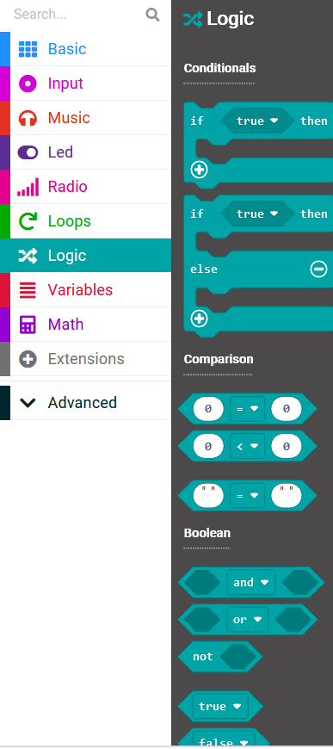
In MakeCode, we have a drawer with tools for Selection

